Slide 1


Slide 2
Company Profile: Lydertron Tech
Company Name: Lydertron Tech
Industry: Industrial Solutions & Services
Headquarters: [Insert Location]
Website: [Insert Website if available]
E-mail : lyderttech@gmail.com
Contact: [7810010275]
About Us
Lydertron Tech is a dynamic and innovative service provider and spare parts supplier, dedicated to delivering high-quality industrial solutions across various sectors. With a strong focus on precision, performance, and reliability, we cater to the needs of manufacturing, automation, and engineering industries.

Slide 3
Our Services
Industrial Service Solutions
We provide expert technical support, maintenance, and installation services for a wide range of industrial equipment, ensuring minimal downtime and optimal performance.
Spare Parts Supply
We are a trusted supplier of high-quality spare parts for various industrial applications, sourced from top manufacturers to guarantee compatibility and durability.
Our Expertise
In-Process Gauging Systems
Supply and support for all makes of in-process gauges including:
Marposs
Accretech
TESPA
And other leading brands
We ensure precision measurement solutions tailored to your production line needs

Slide 4
Compressor Controllers
Comprehensive solutions and spares for all major compressor controller brands:
Atlas Copco
Chicago Pneumatic (CP)
Ingersoll Rand (IR)
ELGI
Chinese brands and other controllers
We provide both hardware and technical services.

Slide 5
Why Choose Lydertron Tech?
One-stop Solution for services and spares
Expert Technicians with deep domain knowledge
Wide Inventory of multi-brand components
Reliable Support for diverse industrial systems
Let Lydertron Tech power your operations with precision and reliability.

Slide 6
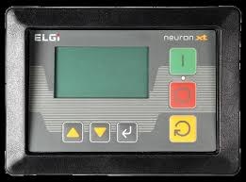
Elgi Neuron XT Compressor controller Repairing 2,000/ Piece
Service location : Pan India
Delivery Time : 24 Hours
Packing Details : Box
Minimum Order Quantity : 1 Piece
We repair :
Note : Display, Sticker available

Slide 7
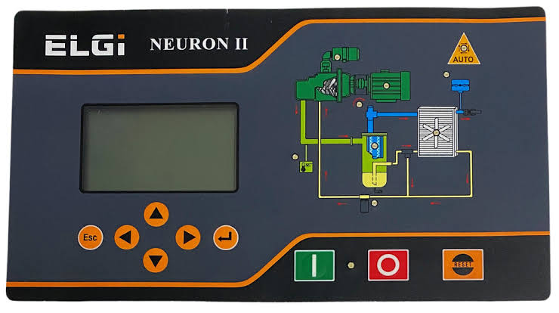
Elgi Neuron II Compressor Controller Repairing 2,000/- Unit
Service Location : Pan India
Prduction capacity :
Delivery Time : 24 Hours
Packing Details : Box
Minimum order quantity : 01 Unit
Note : Display, Sticker available

Slide 8
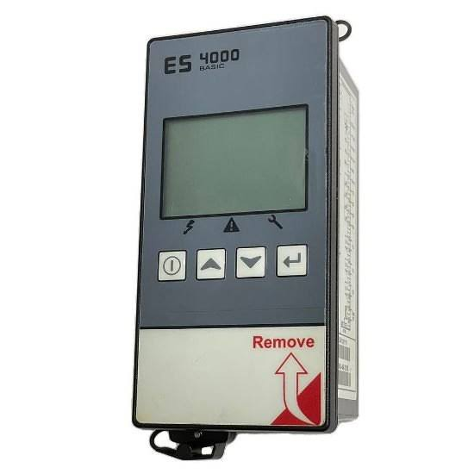
CP ES4000 Compressor Controller Repairing 2,000/- Piece
Compressor Type : Screw Compressor
Brand : Chicago Pneumatic
Design : CP
Usage / Application : Atlas Copco
Capacity Amps : 3
Current Amps : 2
Note : Display, Sticker available

Slide 9
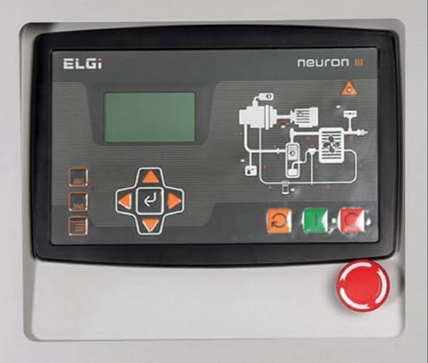
Elgi Neuron III Compressor Controller Repairing 2,000/- Unit
Service Location : Pan India
Production Capacity :
Delivery Time : 24 Hours
Packing Details : box
Minimum order quantity : 01 Unit
Note : Display, Sticker available

Slide 10
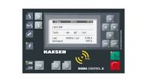
Kaeser Sigma Compressor controller Repairing 2,000/- Piece
Compressor Type : Screw Compressor
Air compressor Model : All
Brand : Kaeser
Delivery Time : 24 Hours
Usage / Application : Display Replacement
Note : Display, Sticker available

Slide 11
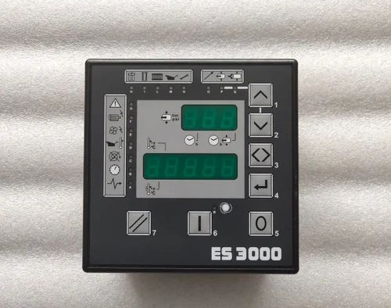
ES3000 Compressor Controller Chicago Pneumatic Micronova Repair 2,000/- Piece
Compressor Type : Screw Compressor
Air Compressor Model : All Type Model
Brand : Chicago Pneumatic
Usage / Application : Compressor Controller
Body Material : Plastic
Note : Display, Sticker available

Slide 12
Kaiser Sigma 2 Compressor display 2000/- Piece
Compressor Type : Screw Compressor
Air Compressor Model : Sigma 2
Minimum order Quantity : 1 Piece
Delivery : 24 Hours

Slide 13
Atlas Copco Elektronikon II Compressor Controller Keypad 4000/ - Piece
Compressor Type : Screw Compressor
Brand : Atlas Copco
Air Compressor Model : All
Finishing : GA
Power Source : 24 volt

Slide 14
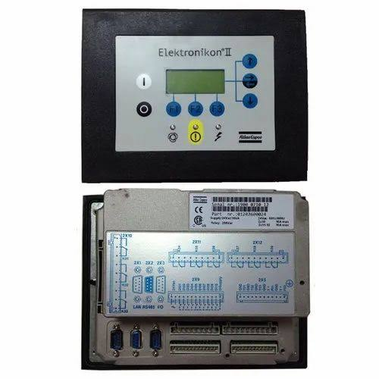
Atlas Copco Electronikon II Compressor controller Repairing 2,000/- Piece
Compressor Type : Screw Compressor
Brand : Atlas Copco
Air Compressor Model : GA All Model VSD
Finishing : VSD
Material : Steel
Power Source : 24 VOLT AC
Note : Display, Sticker available

Slide 15
ES99 Controller Repair 1,500/- Piece
Mode of Service : Repair
We Repair : Printed Circuit Board
Controller Function Type : On – Off
Service Location : Service Center
Delivery : 24 Hours
Note : Display, Sticker available

Slide 16
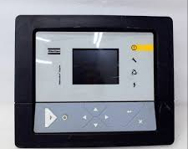
Atlas Copco Graphic Compressor repairing 2,000/- Piece
Compressor Type : Screw Compressor
Brand : Atlas Copco
Air Compressor Model : GA
Power Source: 24 Volt AC
Type : Display
Usage / Application : Compressor
Delivery : 24 Hours
Note : Display, Sticker available

Slide 17
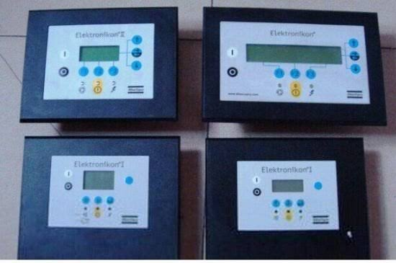
Atlas Copco Compressor Controller Elektronikon Repairing 2,000/- Piece
Compressor Type : Screw Compressor
Air Compressor Model : Atlas Copco
Brand : Atlas Copco
Country of Origin : Made in India
Note : Display, Sticker available

Slide 18
Compressor Controller Repair Services 2,000/- Piece
Model Name / Number : All Model
Types of PLCs : Intrgrated PLC
We Repair : SMPS Section, Temperature, Pressure, Star Problem, Keypads, etc
Delivery : 24 Hours
Note : Display, Sticker available

Slide 19
Atlas Copco Compressor Controller Repairing 2,000/- Piece
Model Name / Number : All Model
Types of PLCs : Intrgrated PLC
We Repair : SMPS Section, Temperature, Pressure, Star Problem, Keypads, etc
Delivery : 24 Hours
Note : Display, Sticker available

Slide 20
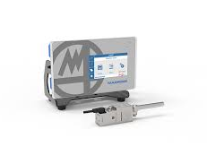
Marposs Online Measurement Gauge Repairing
Service location : All India
Delivery Time : 24 Hours
Packing Details : Box
Minimum Order Quantity : 1 Piece
We repair :
Note : Display, Sticker available

